Slide 1

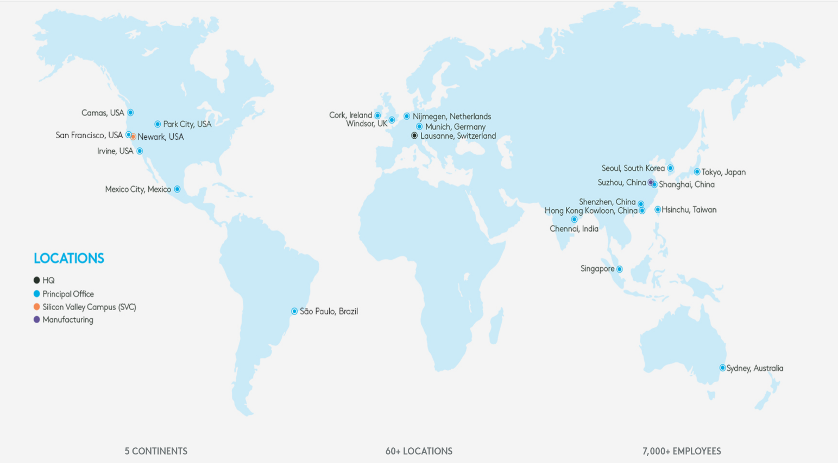
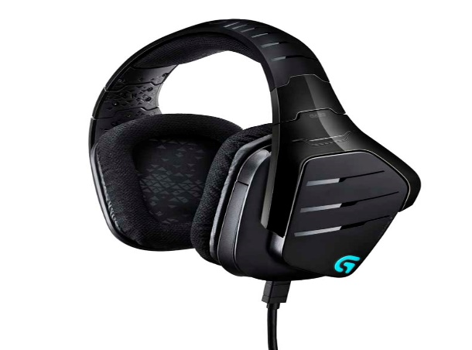
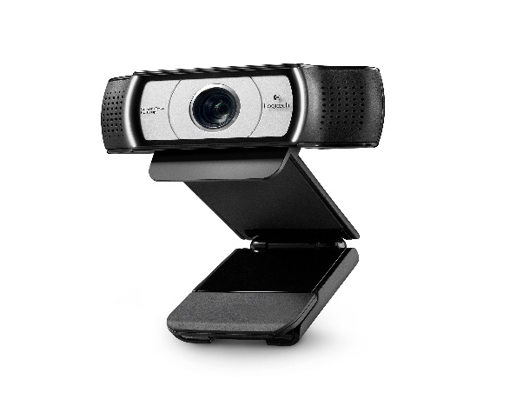
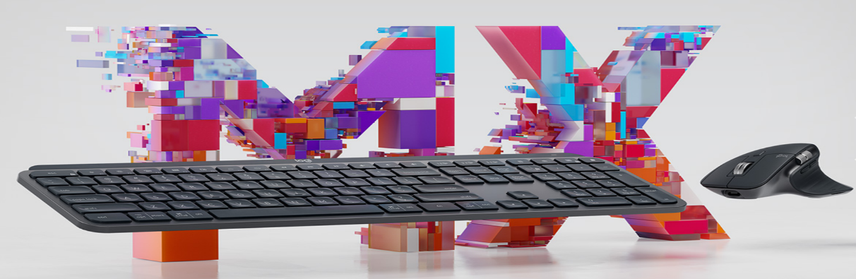
Logitech
團隊:AIoT資訊品牌經營多媒體lab
吳岱儒
陳孝祈
郭柏妍
黃鈺耘

Slide 2
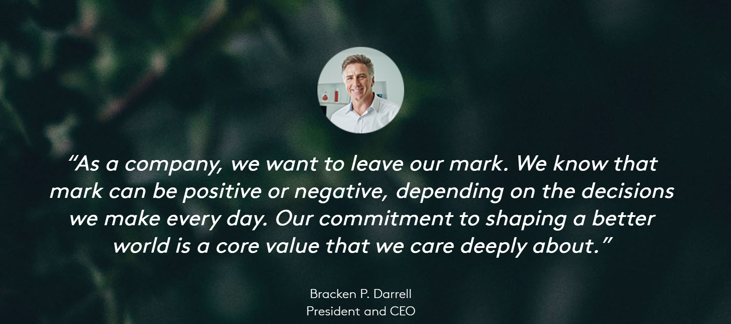
Notes:
You can safely remove this slide. This slide design was provided by SlideModel.com – You can download more templates, shapes and elements for PowerPoint from http://slidemodel.com

Slide 3

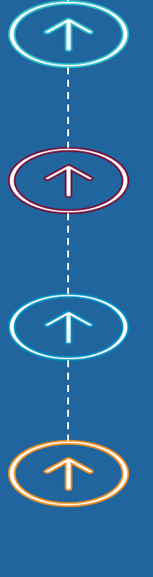
Describe our idea
Near-confocal device
Widely appilication of webcam
Youtuber industry
Friendly environment

Slide 4
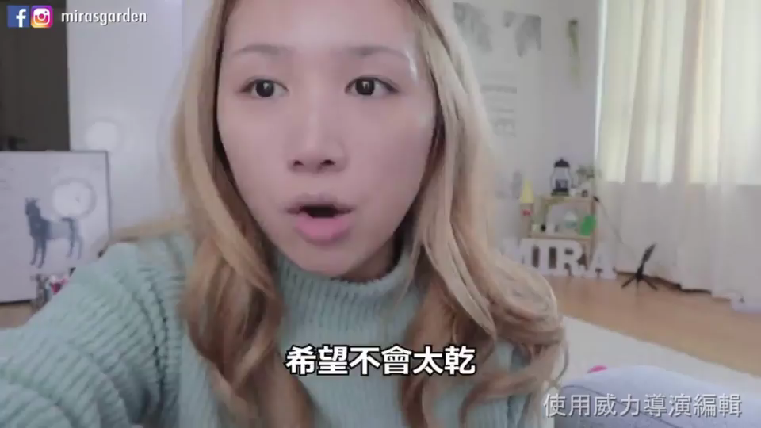
Youtuber Video(by gesture)

Slide 5
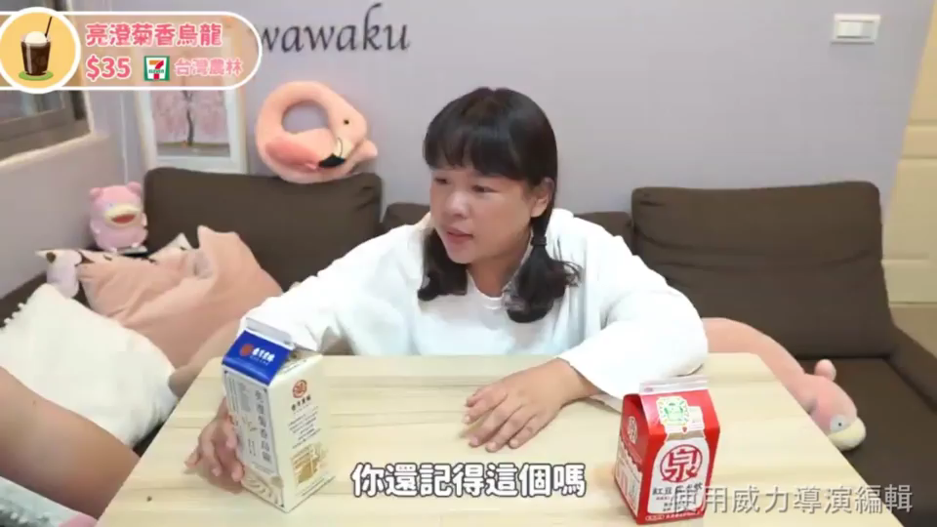
Youtuber Video(No gesture)

Slide 6
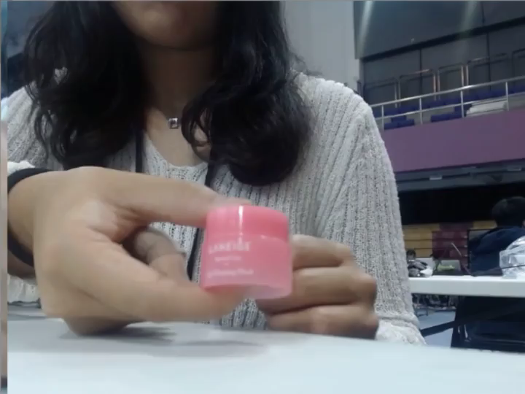
Trying by Logitech webcam

Slide 7
Introduce of Near-confocal device
Open CV
Determine the judgement area
Detect moving object
Return the coordinate of object
to camera (with infrared)
Focus on
the object

Slide 8
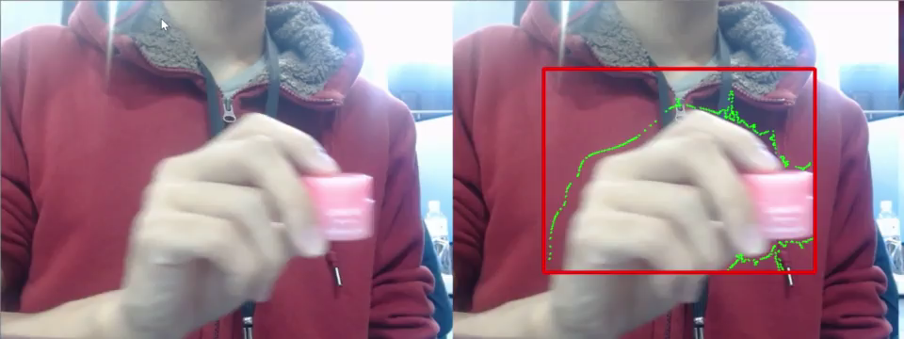
Demo
Notes:
You can safely remove this slide. This slide design was provided by SlideModel.com – You can download more templates, shapes and elements for PowerPoint from http://slidemodel.com

Slide 9
Another Idea:
Speech-to-text techonology
applying on video conference
Notes:
You can safely remove this slide. This slide design was provided by SlideModel.com – You can download more templates, shapes and elements for PowerPoint from http://slidemodel.com

Slide 10
Problems:
Different accent
Hard to communicate
Decrease in efficiency of conference
Notes:
You can safely remove this slide. This slide design was provided by SlideModel.com – You can download more templates, shapes and elements for PowerPoint from http://slidemodel.com

Slide 11
How to solve?
Cloud service: Speech to text
Recognition of different accent
based on user settings
Notes:
You can safely remove this slide. This slide design was provided by SlideModel.com – You can download more templates, shapes and elements for PowerPoint from http://slidemodel.com

Slide 12
Thank you for listening ☺
Notes:
You can safely remove this slide. This slide design was provided by SlideModel.com – You can download more templates, shapes and elements for PowerPoint from http://slidemodel.com

